Slide 1
Technical Aspects
Laetitia Couge
Robin Khatri
Mohamed Nassar
Eduardo Brandao
March 11 2019

Slide 2
Project Definition
Goal :
Build a peer to peer system to exchange files that consists in :
A hub application that distributes the list of players
A player application that deals with file exchange
A librarifier that creates the library file distributed to players that allows file exchange
Definitions :
The file to exchange is called the stuff.
The stuff is shared by sending smaller pieces called books.

Slide 3
Technical choices
Language / version control tool:
Python 3.6+ / GitHub
Protocol
It inspired from BitTorrent but using TCP communication with the hub.
Architecture
Simple architecture: each connection is managed by an instance of object that that deals with 2 threads (one for listening, one for sending) and a message queue. In the player, 2 types of object are used, one for inbound connections, one for outbound connections. A third type of object oversees the behaviour of the 2 previous objects.
Multiaccess resources (book and list of players) are managed via a specific thread and message queue.
The application is implemented to limit the upload and download bandwidth.

Slide 4
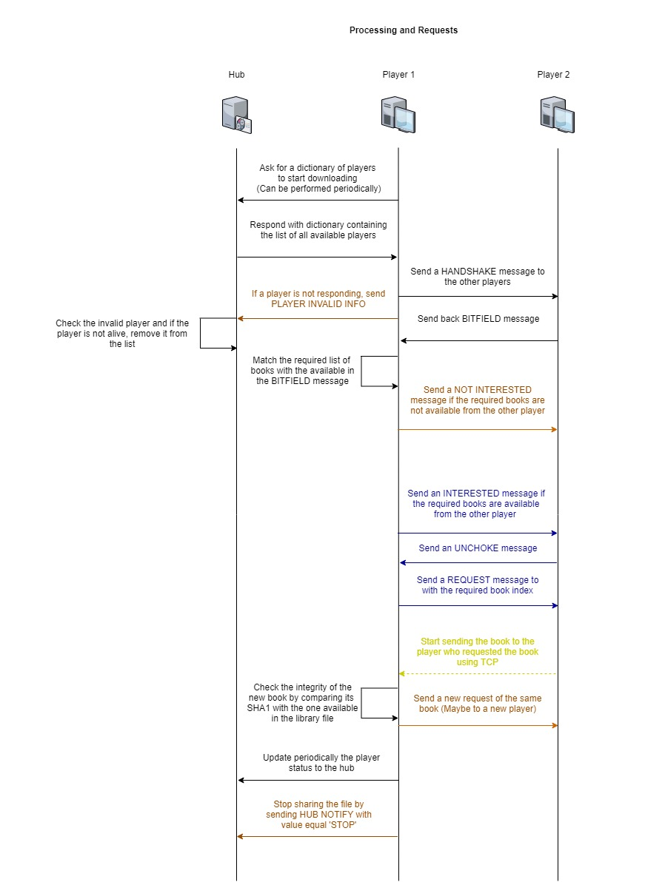
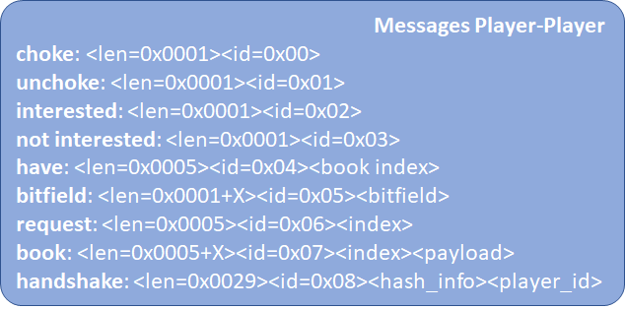
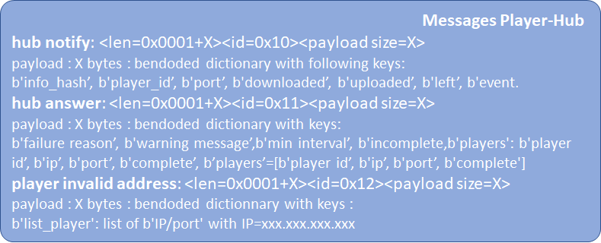
Protocol
All messages are sent via TCP connection

Slide 5
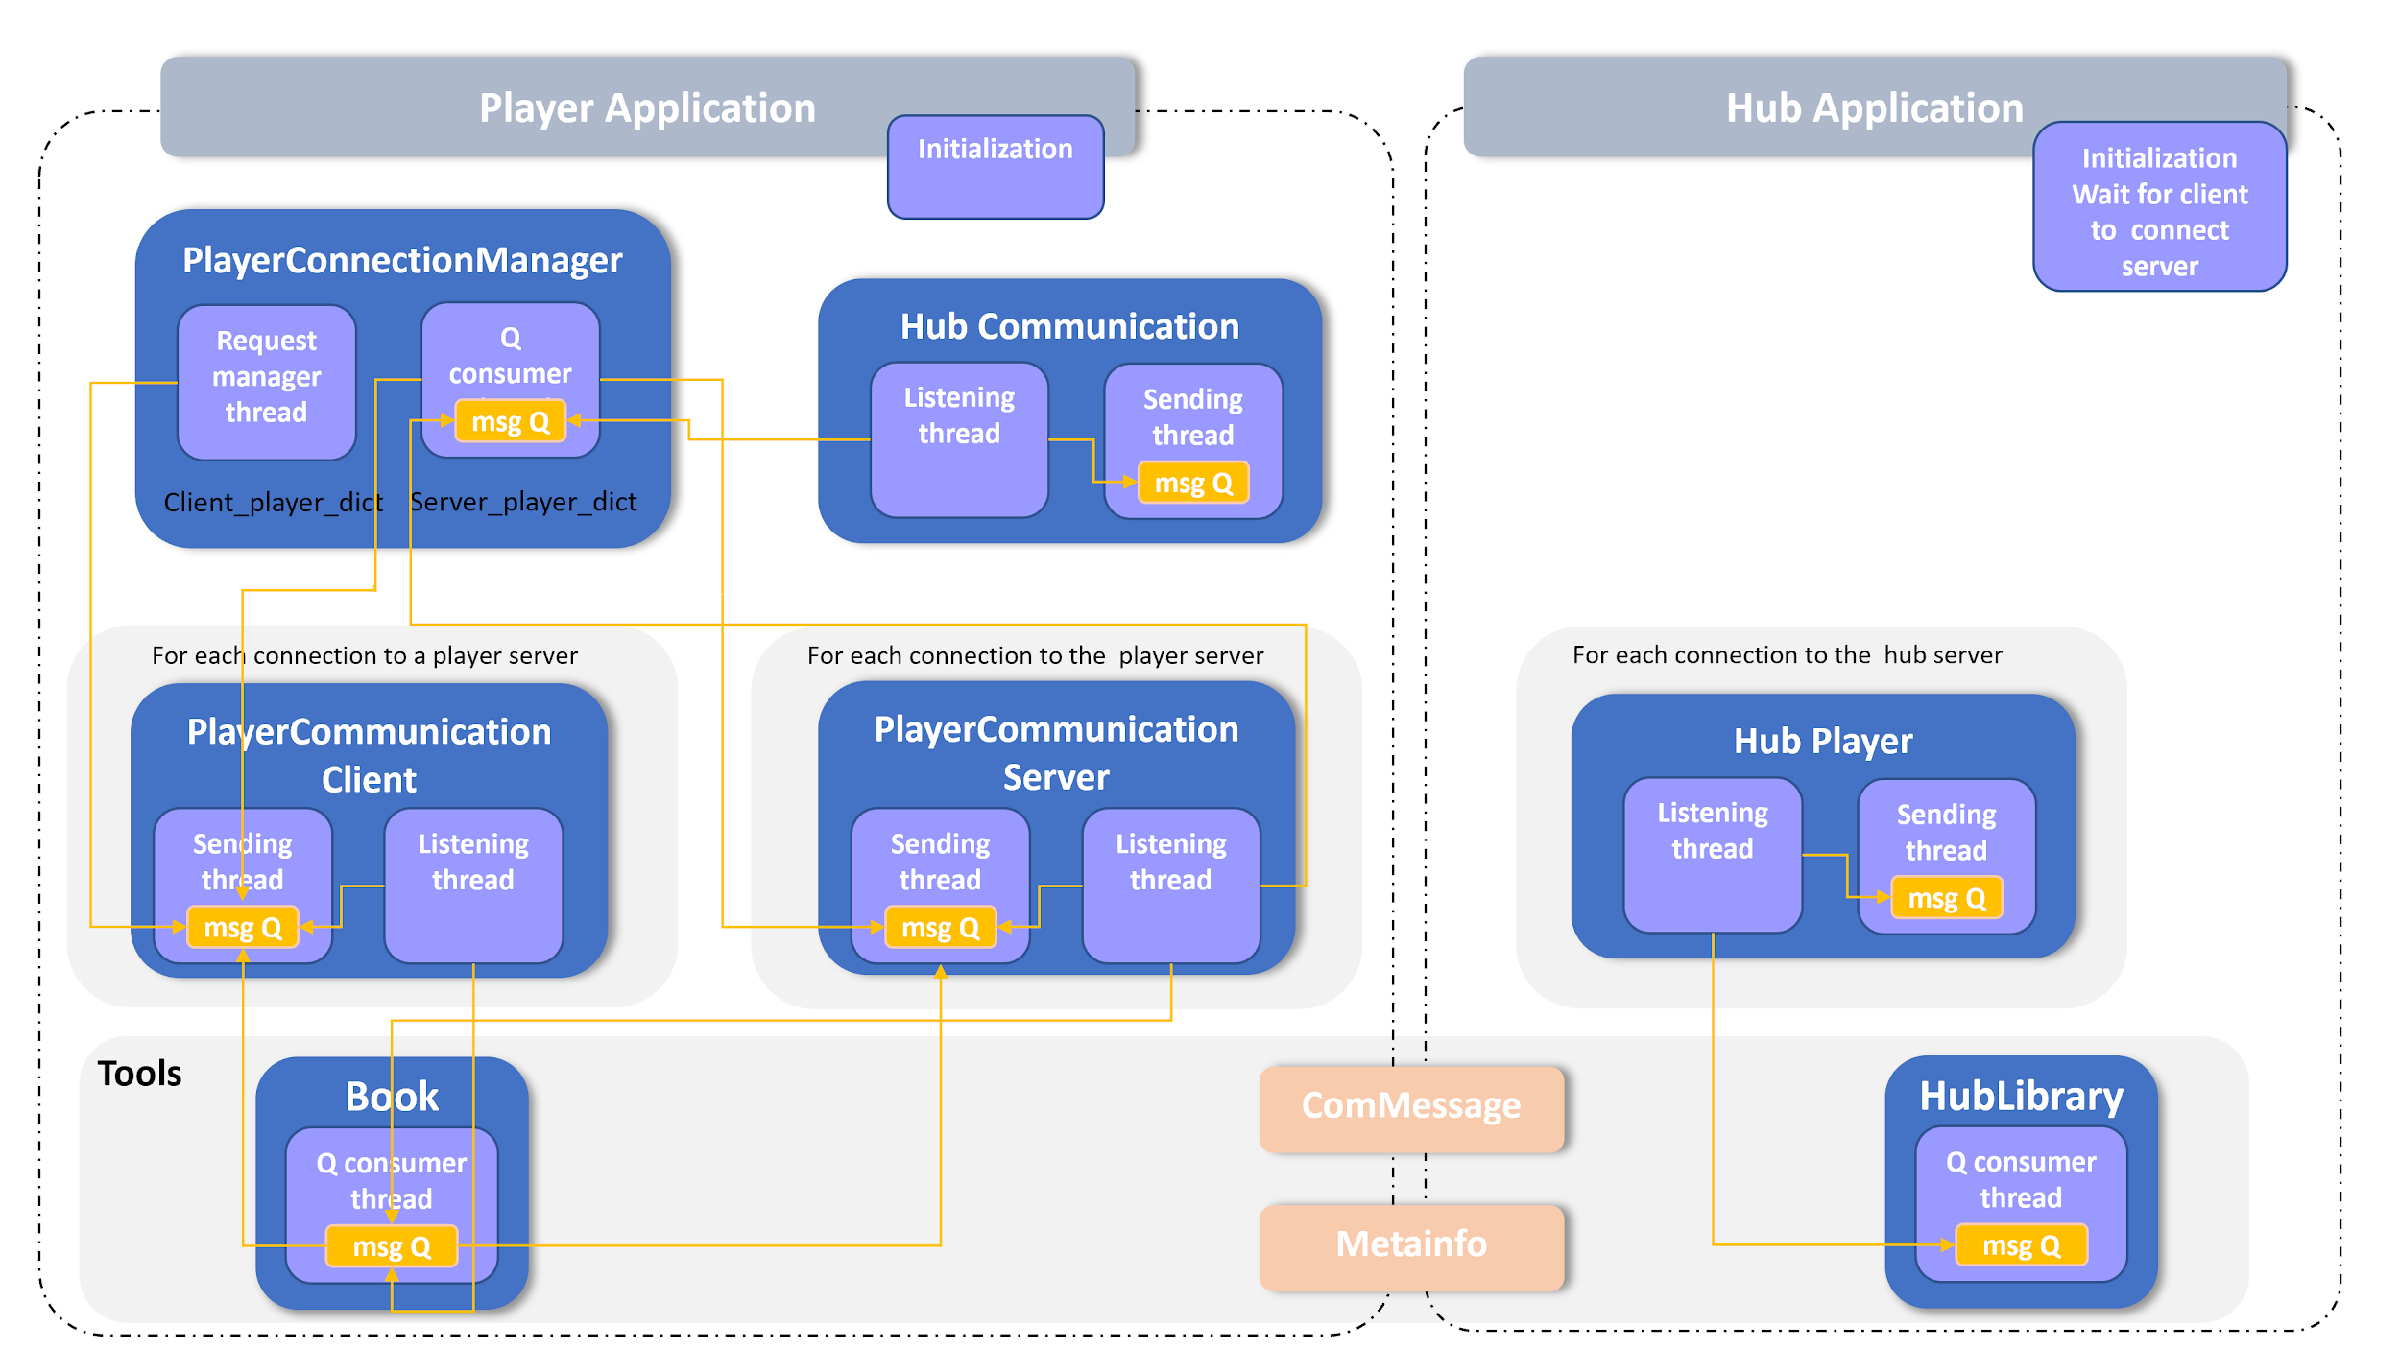
Architecture

Slide 6
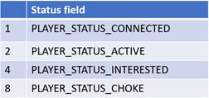
Implementation
Client players are controlled through a status bitfield:
Book request (download)
The PlayerCommunicationManager scans all the bitfields sent by server players and compare them with its own bitfield to get the missing books. These books are organized by frequency order. One of the rarest books is randomly picked and a player that owns this book is also randomly picked. A maximum of 4 requests are performed at a time to maintain a good download speed.
Book delivery (upload)
If there are less than 4 requests at a time, all players are served. If there are more players interested, 4 interested players are kept unchoked and the other players are choked. Every 30 seconds a new random selection of players allowed to download is made. All players have equal chance to download.

Slide 7
Testing
Messages encoding and decoding have been tested at early stage
Test mode is implemented that allow to select the role of a player (server, client or both)
Logger module allows to activate different level of traces
A special set of functions has been designed to test the control of bandwidth by limiting the number of simultaneous requests
A tester that is able to send specific messages on request has been developed

Slide 8
Testing Player
Sender | Message | Parameters
 | bitfield | None / rand
 | have | int: book_index / rand
 | choke | None
 | unchoke | None
server / client | book | int: book_index / rand
 | handshake | None
 | request | int: book_index / rand
 | interested | None
 | not_interested | None

